Slide 1
Scholarsphere
Jaishyam Reddy Reddivari

Slide 2
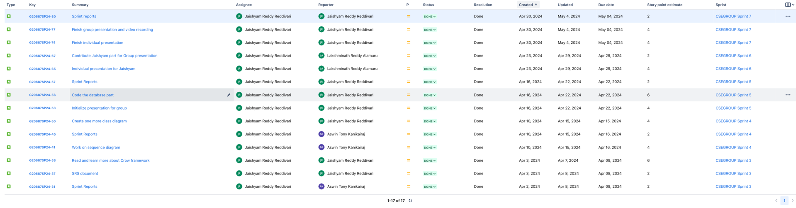
Stories

Slide 3
Sprint Overview
Sprint | Number of stories closed | Number of stories rolled over | Story points
Sprint 1 | 1 | 0 | 6
Sprint 2 | 2 | 0 | 7
Sprint 3 | 3 | 0 | 10
Sprint 4 | 3 | 0 | 10
Sprint 5 | 3 | 0 | 12
Sprint 6 | 2 | 0 | 6
Sprint 7 | 3 | 0 | 10
The average number of closed stories per sprint are 2.4.
The average number of stories rolled over are 0.
The total number of story points that I have logged are 61.

Slide 4
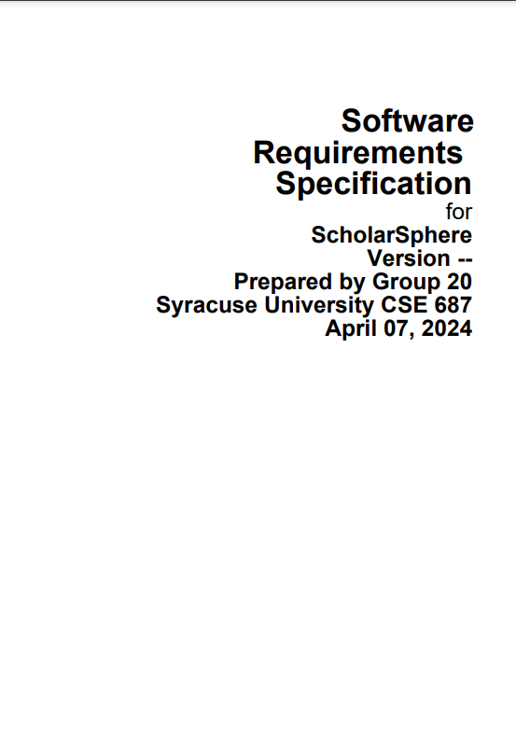
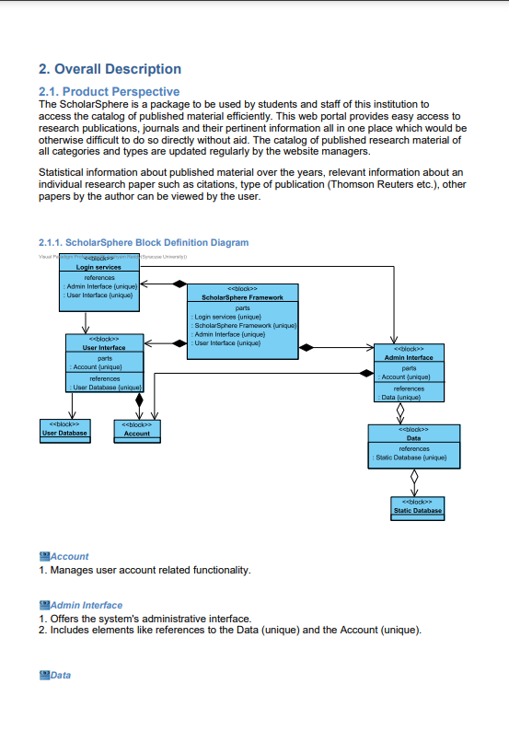
SRS Document
The SRS document is made using Visual Paradigm.

Slide 5
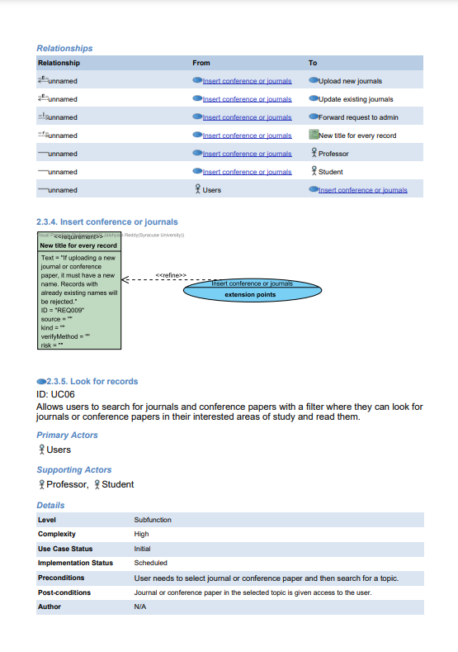
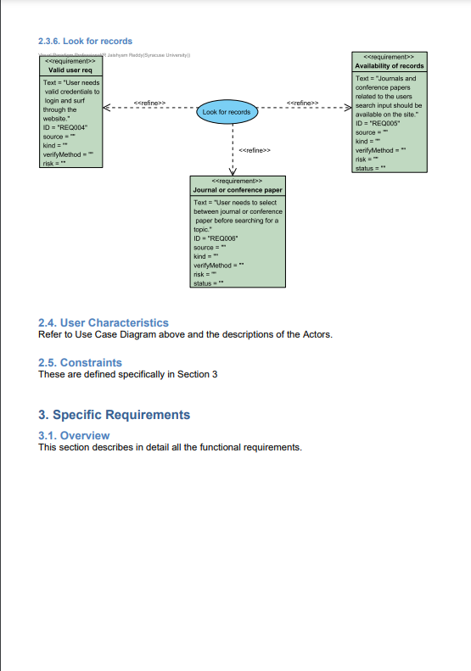
SRS Document
SRS Document GitHub link

Slide 6
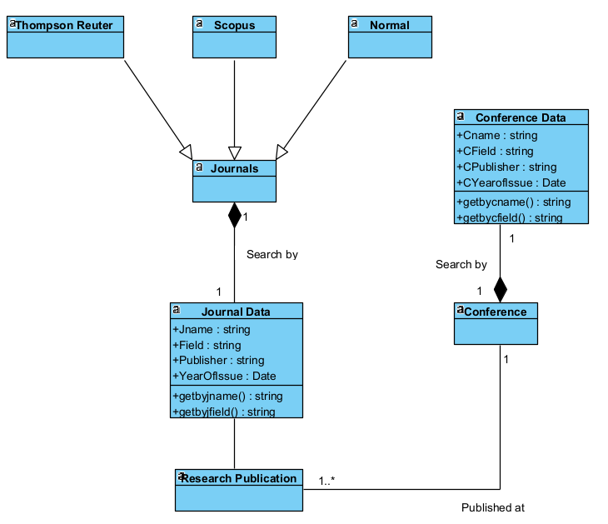
Class Diagram
Class Diagram GitHub link

Slide 7
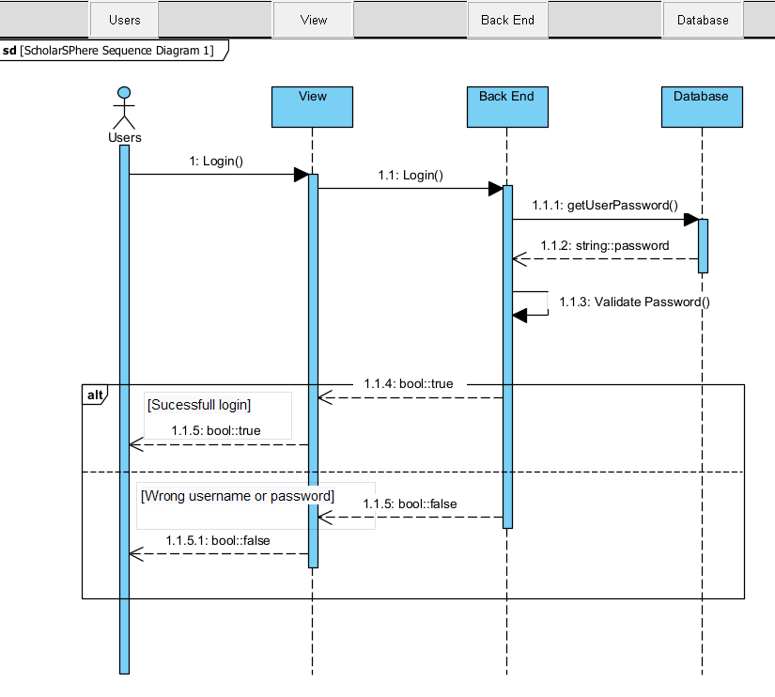
Sequence Diagram

Slide 8
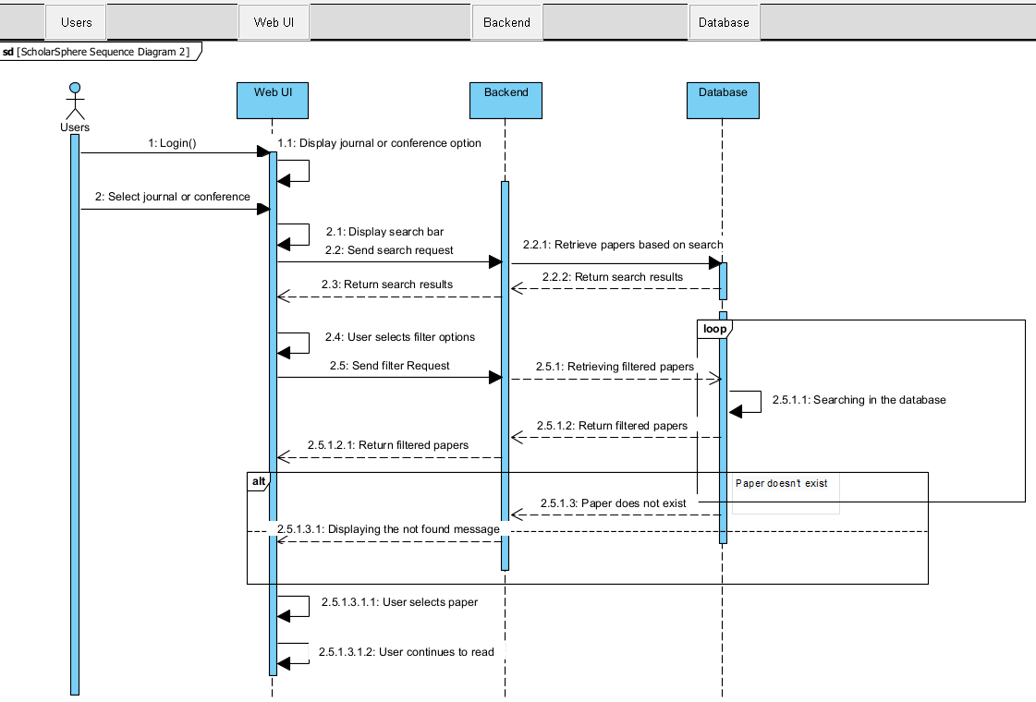
Sequence Diagram
Sequence Diagram GitHub link

Slide 9
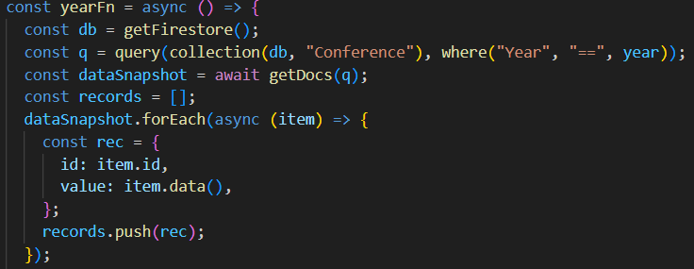
Database Code
This is a snippet from the entire code, this part of the code retrieves records from the database(Firebase) collection
named “Conference” based on a specific year.

Slide 10
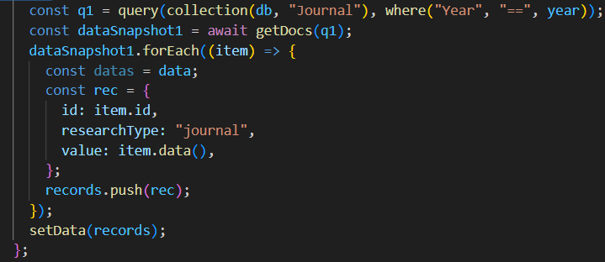
Database Code
This is a snippet from the entire code, this part of the code retrieves records from the database(Firebase) collection
named “Journal” based on a specific year.
Code GitHub link

Slide 11
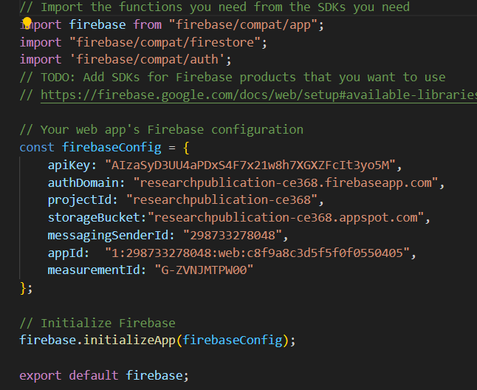
Database Code
This part of the code lets the web page to interact with the database on firebase.

Slide 12

When a user enters their credentials and click login,a query is constructed to look for those credentials on the database
and validate them.

Slide 13
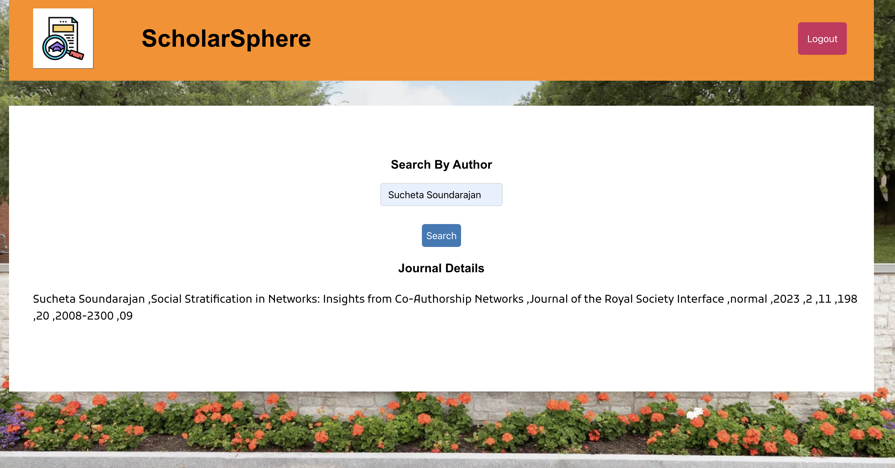
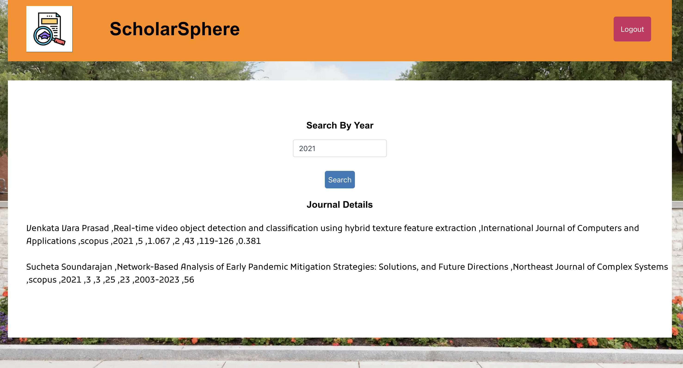
When the user clicks search, a query is constructed to
look in the collection called “Journals” based on the
“Author Name”.
When the user clicks search, a query is constructed to
look in the collection called “Journals” based on the
“Year”.

Slide 14
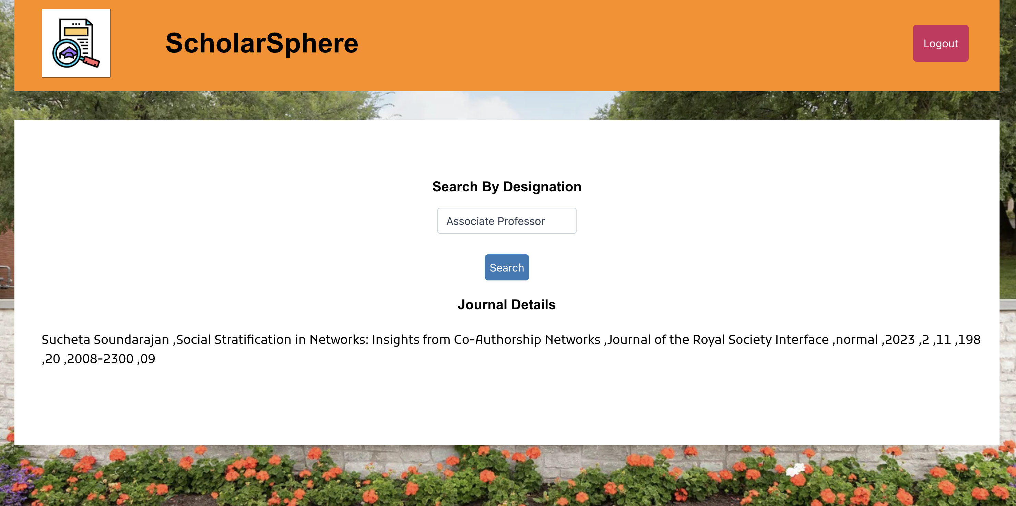
Similarly, here the query is constructed to look in the collection “Journals” based on “Designation”.
The above shown portions of demo are for journals. Same kind of search mechanism is employed for conference
papers as well.
The portions showed are for user interface. Similar kind of approach is taken for admin interface too.

Slide 15
Thank you

